Slide 1
SAFEPASS: AN IMPLEMENTATION OF AUTOREGRESSIVE INTEGRATED MOVING AVERAGE (ARIMA) FOR CROWD FORECASTING APPLIED IN QUARANTINE PASS
Presented By:
Joane Marie F. Llamera

Slide 2
TABLE OF CONTENTS
01
03
04
Background of the Study
Theoretical Framework
Methodology
02
Objectives and Scope of the Study

Slide 3
01
Background of the Study

Slide 4
Background of the Study
01
A coronavirus outbreak in Wuhan, China, was originally reported more than a year ago. Despite the fact that numerous vaccines are already available, most countries are still fighting the epidemic as new virus variants emerge.
Researchers studied direct transmission of Covid-19 virus in a shopping centre in Wenzhou, China. Indirect transmission was shown to occur as a result of contamination of common objects and virus aerosolization in confined places. The study was published in the Journal of Infectious Diseases.

Slide 5
Background of the Study
01
Researchers have also emphasized the need of social separation as a viable approach of COVID-19 transmission prevention and that it should remain a part of individual and institutional responses to the epidemic in the coming years.
The Philippine government's instrument for assessing, monitoring, controlling, and preventing the spread and local transmission of COVID-19 is the Inter-Agency Task Force for the Management of Emerging Infectious Diseases (IATF – EID). They classify Provinces, Highly Urbanized Cities (HUCs), and Independent Component Cities (ICCs).

Slide 6
Background of the Study
01
Forecasting is critical for effective governmental decision-making, supply chain resource management, and understanding extremely tough political decisions such as imposing a lockdown or curfews during a pandemic.
The most stringent quarantine grade is Enhanced Community Quarantine, which requires tight home quarantine in all families. People's mobility restricted to vital goods and services, as well as employment in public and private hospitals, health, emergency and frontline services, essential goods producers, and so on. A quarantine pass enabling one person per home to purchase necessary products or services is issued to communities under an Enhanced Community Quarantine (ECQ).

Slide 7

Background of the Study
01
The present quarantine pass implementation is done manually, which has resulted in a number of difficulties such as face to face interaction during the issuance of quarantine pass and selling of quarantine passes by barangay officials.
These challenges, as well as the human work involved in generating and validating quarantine passes, can be addressed by developing a mobile responsive application. The suggested application, when combined with a decision support system, will allow the government and communities to make more informed decisions in order to limit COVID-19 virus transmission.
SafePass

Slide 8
02
Objectives of the Study and Scope

Slide 9
Objectives of the Study
02
The main objective of this capstone project is to develop a mobile responsive web application that would automate the process of generating and validating quarantine pass and show statistical data for a decision-making system.
Specifically, this capstone project seeks to achieve the following objectives:
1. To provide digital quarantine passes for residents that will be validated at essential establishments by using Quick Response Code scheme.
2. To provide information to residents about the current crowd count of essential establishments.
3. To provide users with crowd forecast on essential establishments for upcoming days by using Autoregressive Integrated Moving Average (ARIMA) model.

Slide 10
Scope and Limittations
02
Create a mobile responsive online application that would automate the laborious process of generating and validating quarantine passes while also providing users with a crowd forecasting feature.
Will use dummy data for information of residents, households per barangay, barangay officials and essential establishments to give emphasize on how the automated system can provide usable crowd forecasts during the implementation of Enhanced Community Quarantine for better decision making and even risk management.
Will not cover other types of quarantine passes

Slide 11
03
Theoretical Framework

Slide 12
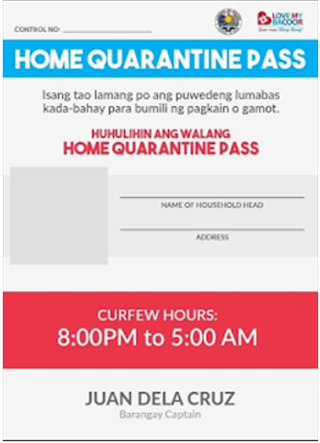
Theoretical Framework
03
Quarantine Pass Manual Process
The generation and issuance of quarantine pass is purely manual process done by LGU officials. Quarantine pass templates are printed out on a piece of paper and distributed either in the Barangay halls or delivered on house-to-house basis in their areas of responsibility.
At checkpoints/essential establishment, the quarantine pass will need to be presented to the checkpoint/barangay officials for manual verification.

Slide 13
12,841
Estimated number of households in Molino IV Bacoor, Cavite
Based on PSA 2015 census
Notes:
In Molino IV, a barangay in the city of Bacoor, Cavite, the process of implementing home quarantine passes is done manually by designated LGU or barangay officials. Quarantine Pass templates are printed on a paper with the details of their barangay and some blank fields to be manually populated by the individual who will utilize it. The dissemination process of quarantine pass is for the barangay officials to deliver on house-to-house basis. In case the issued quarantine pass was lost, the resident should request for a replacement from their respective Barangay Hall.
In the 2015 census done by Philippine Statistics Authority, the estimated population in Barangay Molino IV, Bacoor Cavite is 51, 362 and the average number of people per household is 4. Given this data, there would be around 12,841 quarantine passes to be issued to each household on a manual basis requiring a lot of time and effort.

Slide 14
Theoretical Framework
03
Quick Response Code
QR Code is a two-dimensional symbol designed by a significant Toyota group company, Denso wave in 1994.
Both the horizontal and vertical axes of QR codes carry information. When compared to ‘traditional' barcodes, this allows for significantly more raw data to be inserted.
They have a high encoding capacity enhanced by error correction facilities, they have a small size and a low cost.
They are robust to the copying process, easy to read by any device and any user.
There are two regions in this square pattern: the encoding region and the function patterns.
QR codes can hold a variety of information in addition to being used to transmit links.
Notes:
These can be numeric, alphanumeric, or binary data, with a maximum storage size of 2953 bytes.
The location where the encoding region indicates the data encoding is the focus of the function patterns. Finder patterns, timing patterns, and alignment patterns are all part of the function pattern. Finder patterns are three frequent structures found on the three corners of a QR code symbol. The Finder pattern is used to determine the symbol's proper orientation.
The rest of the region is the encoded region, which stores data code words and error correcting code words.

Slide 15
Theoretical Framework
03
Time Series Forecasting
A forecasting method is a method for calculating forecasts based on current and historical data.
(b) Univariate approaches, in which forecasts are based solely on the current and previous values of a single series, potentially supplemented by a time function such as a linear trend.
(c) Multivariate approaches, in which the forecasts of one or more extra time series variables, referred to as predictor or explanatory variables, are based, at least in part, on the values of one or more additional time series variables.
A time series is a set of values observed sequentially through time.
The series may be denoted by X1 , X2 ,☹, Xt , where t refers to the time period and X refers to the value. If the X’s are exactly determined by a mathematical formula, the series is said to be deterministic.
Notes:
Depending on the frequency, a time series can be of yearly (ex: annual budget), quarterly (ex: expenses), monthly (ex: air traffic), weekly (ex: sales qty), daily (ex: weather), hourly (ex: stocks price), minutes (ex: inbound calls in a call canter) and even seconds wise (ex: web traffic).

Slide 16
Theoretical Framework
03
Autoregressive Integrated Moving Average (ARIMA) Model
An autoregressive integrated moving average, or ARIMA, is a statistical analysis model that uses time series data to either better understand the data set or to predict future trends.
ARIMA modeling is one of the best modeling strategies for forecasting a univariate time series.
The ARIMA model seeks to explain data by using time series data on previous values and making predictions using linear regression.
Notes:
It is a generalization of the simpler AutoRegressive Moving Average and adds the notion of integration.
ARIMA, short for ‘Auto Regressive Integrated Moving Average’ is actually a class of models that ‘explains’ a given time series based on its own past values, that is, its own lags and the lagged forecast errors, so that equation can be used to forecast future values.

Slide 17
Theoretical Framework
03
Autoregressive Integrated Moving Average (ARIMA) Model
• Autoregression (AR): a model in which a changing variable regresses on its own lagged (or prior) values.
• Integrated (I): denotes the differencing of raw observations to allow the time series to stabilize (i.e., data values are replaced by the difference between the data values and the previous values).
• Moving average (MA): A moving average model applied to lagged observations incorporates the dependency between an observation and a residual error.
Notes:
This acronym is descriptive, capturing the key aspects of the model itself. Briefly, they are:
AR: Autoregression. A model that uses the dependent relationship between an observation and some number of lagged observations.
I: Integrated. The use of differencing of raw observations (e.g. subtracting an observation from an observation at the previous time step) in order to make the time series stationary.
MA: Moving Average. A model that uses the dependency between an observation and a residual error from a moving average model applied to lagged observations.

Slide 18
Theoretical Framework
03
Autoregressive Integrated Moving Average (ARIMA) Model
ARIMA treats each component as a parameter with a consistent nomenclature.
•p: also called the lag order which refers to the number of lag observations in the model.
•d: The degree of differencing refers to the number of times the raw observations are differed.
•q: The order of the moving average is the size of the moving average window.
The parameters p and q are called the AR and MA orders, respectively. Because of its "integrate" stage, ARIMA forecasting, also known as Box and Jenkins forecasting, can deal with non-stationary time series data.
Notes:
The parameters are integers that must be defined in order for the model to work. They can also be set to 0, indicating that they would be ignored in the model.
the "integrate" component entails differencing the time series in order to convert a non-stationary one into a stationary one. ARIMA(p, d, q) is the general form of an ARIMA
ARIMA model in words:
Predicted Yt = Constant + Linear combination Lags of Y (up to p lags) + Linear Combination of Lagged forecast errors (up to q lags)

Slide 19
Theoretical Framework
03
Box-Jenkins Methodology
Box - Jenkins Analysis refers to a systematic method of identifying, fitting, checking, and using integrated autoregressive, moving average (ARIMA) time series models.
Box - Jenkins method is used to transform a non-stationary series into a stationary one.
Notes:
Introduced by George Box and Gwilym Jenkins in 1970.
can deal with non-stationary time series data.

Slide 20
Theoretical Framework
03
Box-Jenkins Methodology
Diagnostic Checking
Data Preparation/ Identification
Providing a set of computer programs to help users identify appropriate values for p and q, as well as P and Q, and estimate the parameters involved
Providing guidelines for making the series stationary in both its mean and variance
Forecasting
Model Selection and Parameter Estimation
Model is used for forecasting
Suggesting the use of autocorrelations and partial autocorrelation coefficients for determining appropriate values of p and q
Notes:
Data preparation involves transformations and differencing. Transformations of
the data (such as square roots or logarithms) can help stabilize the variance in a
series where the variation changes with the level. This often happens with business
and economic data. Then the data are differenced until there are no obvious patterns
such as trend or seasonality left in the data. “Differencing” means taking the difference
between consecutive observations, or between observations a year apart. The
differenced data are often easier to model than the original data.
2 Model selection in the Box-Jenkins framework uses various graphs based on the
transformed and differenced data to try to identify potential ARIMA processes
which might provide a good fit to the data. Later developments have led to other
model selection tools such as Akaike’s Information Criterion.
3 Parameter estimation means finding the values of the model coefficients which
provide the best fit to the data. There are sophisticated computational algorithms
designed to do this.
4 Model checking involves testing the assumptions of the model to identify any areas
where the model is inadequate. If the model is found to be inadequate, it is
necessary to go back to Step 2 and try to identify a better model.
5 Forecasting is what the whole procedure is designed to accomplish. Once the
model has been selected, estimated and checked, it is usually a straight forward
task to compute forecasts. Of course, this is done by computer.

Slide 21
Methodology
04

Slide 22
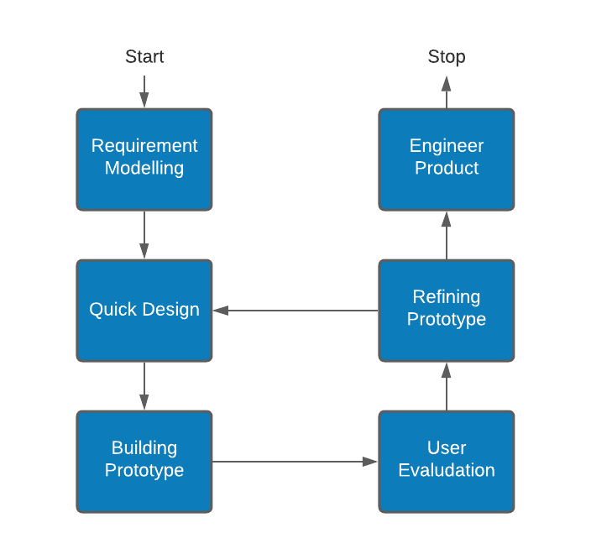
Methodology
04
The Prototype Model will be used by the proponent as a guide in developing the project which is a Systems Development Methodology (SDM) within which a paradigm output (or an early approximation of a final system or product) is constructed, tested, and then reworked.
Notes:
Using this model, it will enhance the usability, design quality of the proposed application and it will also make the development process more cost-efficient since the development cycle becomes shorter.
This first step involves understanding the basics product requirements. The proponent of this capstone project possess firsthand experience on how the Quarantine Pass is obtained and utilized when going outside of residence. Apart from the proponent’s personal knowledge, it is also in this stage that the proponent had requested permission from local government authorities and other parties to conduct the study and where all relevant data and information were examined.
To build a logical model of the application, preliminary investigation was conducted via interviews with the involved parties. With these interviews, the researcher was able to identify the transactions involved and analyzed them against the proposed solution. This collected information had enabled the researcher to identify critical decisions geared toward implementing the proposed application.

Slide 23
Methodology
04
Below are the functional requirements grouped by specific role:
Resident
O Register and Login – Register to gain access to the system.
O Generate Quarantine Pass – Generate a digital quarantine pass by providing personal information to be validated by the system.
O View Statistical Information – Access to the dashboard on actual crowd count and forecast per registered essential establishment.
Notes:
In generating the digital quarantine pass, QR code scheme will be implemented to help to speed up the flow of information. This would allow residents to download the QR code that will be scanned at essential establishment premises upon entry and exit.
Date time stamps of the entry and exit activity will be logged in the system and will be analyzed to generate crowd demographics. ARIMA model will be used to analyze the time series data on SafePass.

Slide 24
Methodology
04
Below are the functional requirements grouped by specific role:
Essential Establishment Personnel
O Register and Login – Register to gain access to the system.
O Scan Quarantine Pass – Scan quarantine passes for individuals entering and leaving the essential establishment premises.
O View Statistical Information - Access to the dashboard on the establishment’s actual crowd count and forecast.

Slide 25
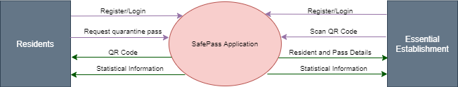
Methodology
04
Context Diagram
Notes:
The context diagram in Figure 4.5 illustrates the authorized users input to the system and the expected output information. The target users are the residents and essential establishment personnel. The expected output of the proposed application is: Digital Quarantine Pass (QR Code), Quarantine Holder Information and Quarantine Pass Status, Crowd Count per Establishment and Crowd Forecast per Establishment.

Slide 26
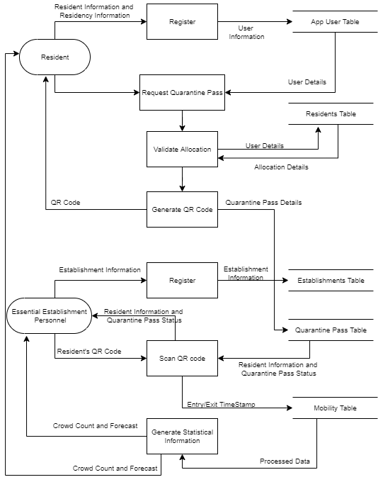
Methodology
04
Data Flow Diagram

Slide 27
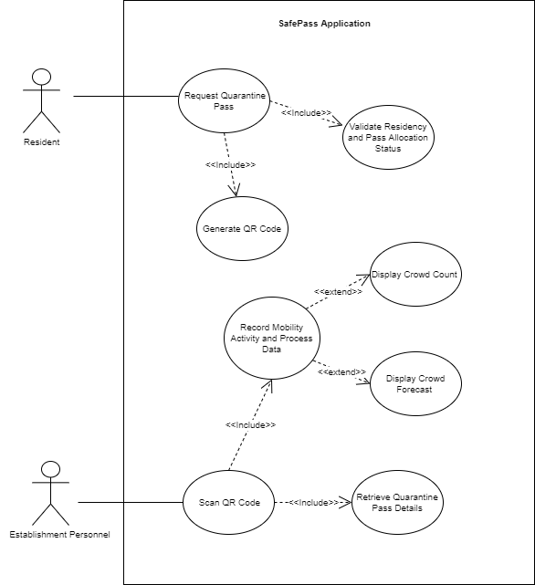
Methodology
04
Use Case Diagram

Slide 28
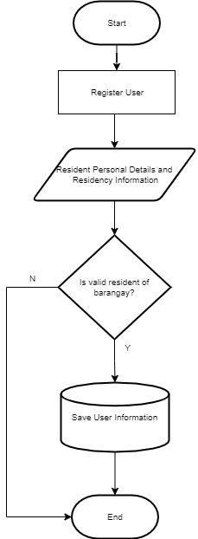
Methodology
04
System Flow Charts
Resident System Registration Flow
Notes:
Figure 4.8 shows the flow of resident registration wherein they need to provide their personal information, residency information and attach a valid ID for verification purposes. Personal information includes First Name, Middle Name, Last Name, Date of Birth and Contact Number. Residency information such as Barangay Name and Street/Subdivision/Purok/Zone are needed to validate if the user belongs to the correct Barangay base on the resident’s database in the system. Lastly, the user must provide an identification card and upload an image for further system validation.

Slide 29
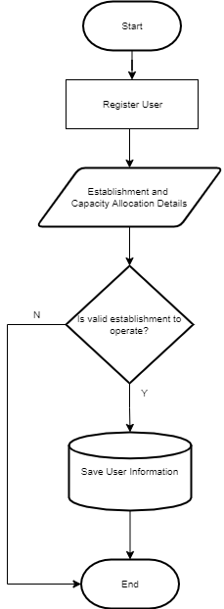
Methodology
04
System Flow Charts
Essential Establishment System Registration Flow
Notes:
The illustration on Figure 4.9 defines the process flow when an essential establishment registers in the application. Information such as Registered Business Name, Registered Business Owner Name, Registered Business Address/Barangay, number of people allowed in the premises shall be provided together with Business Registration Certificate and will be validated against the essential establishment’s database which contains a list of permitted establishments to operate during Enhanced Community Quarantine.

Slide 30
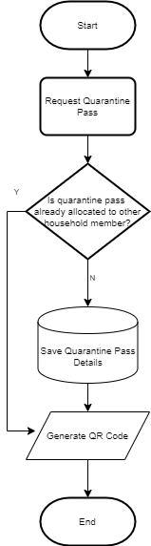
Methodology
04
System Flow Charts
Generate Quarantine Pass Flow
Notes:
The process flow for the generation of quarantine pass is illustrated in Figure 4.10 wherein the system will check on what household the user belongs to and validate if the quarantine pass allotted for their household was already granted. If no other member of the same household has not requested for a quarantine pass, then the system will generate a QR Code and update the database that a quarantine pass was already granted. The user will have the ability to download the QR Code or view it on the system every time they login.

Slide 31
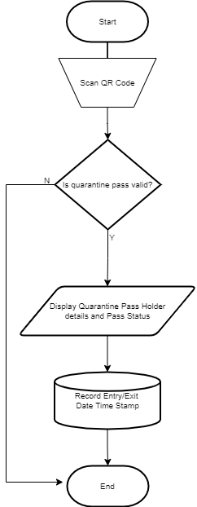
Methodology
04
System Flow Charts
Scan Quarantine Pass Flow
Notes:
Figure 4.11 displays the system flow when a QR Code is scanned in an establishment. Resident with valid QR Code should present the QR code to the essential establishment personnel using SafePass application upon entry/exit. The system will then validate the QR code validity and should display the quarantine pass holder’s Full Name, Barangay, and the uploaded Image. This action will record the entry/exit date and time stamp of the holder and the establishment name in the system database.

Slide 32
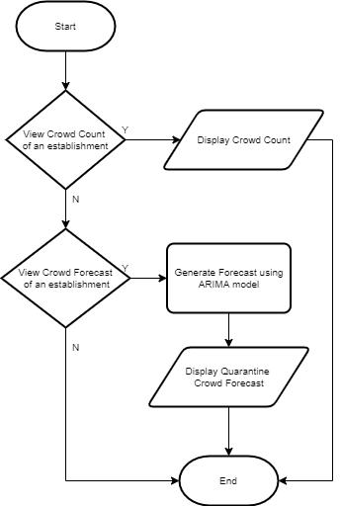
Methodology
04
System Flow Charts
Generate Statistical Information Flow
Notes:
In the process flow presented in Figure 4.12, a user will have the ability to view the current crowd count in an essential establishment registered in SafePass application. The crowd count information will provide details if a certain establishment is already reaching their allowed capacity which will help the residents decide whether to proceed or not. By using the historical data in the system, a weeklong crowd forecast can be generated which will aid the residents in planning when is the best time and day of the week should they go to the establishment to avoid crowd exposure. The same statistical information can also be utilized by the establishment in risk management and planning.

Slide 33
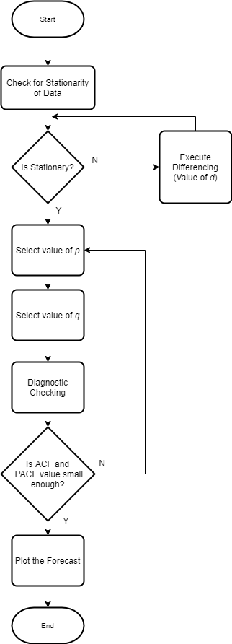
Methodology
04
System Flow Charts
ARIMA Forecasting Flow

Slide 34
Thank You!

Slide 35
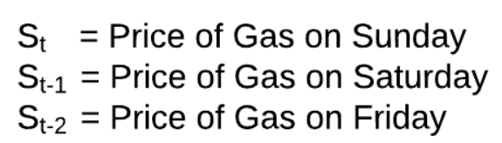
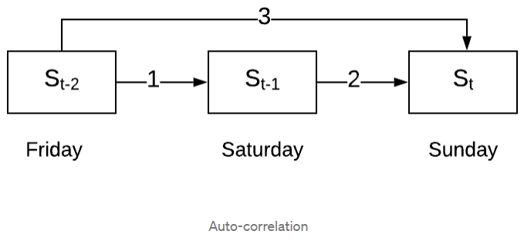
Correlation
03
This mutual relationship between day prices here, is called correlation. If values of two variables increase (or decrease) together then they are said to have a positive correlation. If the value of one variable increases and the other decreases (or vice versa) then they have a negative correlation.
Auto-correlation, which considers both direct and indirect effects

Slide 36
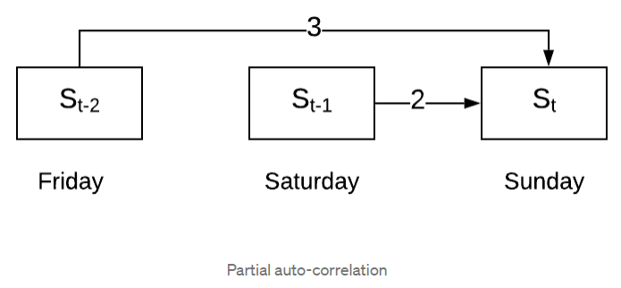
Correlation
03
Partial Auto-correlation, which considers only the direct effects

Slide 37
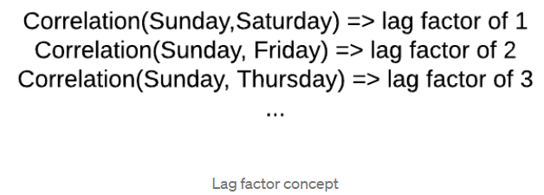
Lag Factor
03
Auto-correlation and Partial Auto-correlation are important to understand before moving on to ARIMA as they are crucial for selecting the right parameters for your model.

Slide 38
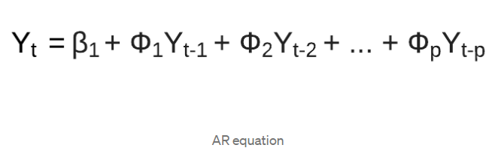
AR Equation
03
Auto Regressive (AR) model is a specific type of regression model where, the dependent variable depends on past values of itself.
The respective weights(Ф1,Ф2 …Фp) of the corresponding lagged observations are decided by the correlation between… that lagged observation and the current observation. If the correlation is more, the weight corresponding to that lagged observation is high (and vice-versa).
The (p) is called the lag order. It represents the number of prior lag observations we include in the model i.e. the number of lags which have a significant correlation with the current observation.

Slide 39
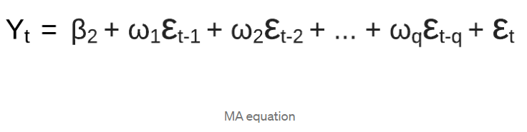
MA Equation
03
This model factors in errors from the lagged observations. The effects of these previous(lagged) observation errors, on the current observation, depends on the auto-correlation between them.
The ε terms represent the errors observed at respective lags and the weights (ω1,ω2 …ωq) are calculated statistically depending on the correlations.
(q) represents the size of the moving window i.e. the number of lag observation errors which have a significant impact on the current observation. Its similar to the lag order(p), but it considers errors instead of the observations themselves.
Notes:
Moving Average (MA) model works by analysing how wrong you were in predicting values for the previous time-periods to make a better estimate for the current time-period.

Slide 40
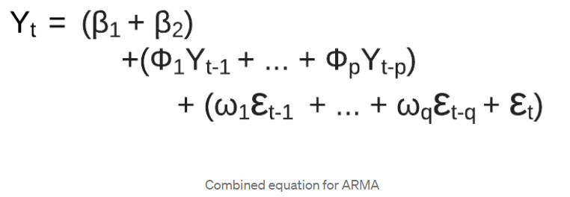
ARMA Equation
03
MA model supplements the AR model by taking into considerations, the errors from the previous time-periods thereby helping to get a better estimate.

Slide 41
Stationarity
03
Stationarity: a key requirement for external validity of time series regression Stationarity says that history is relevant:
It should satisfy the following 3 conditions:
1. Mean (μ) is constant
2. Standard Deviation (σ) is constant
3. Seasonality doesn’t exist
These conditions can be visually analysed by studying the plot against time.

Slide 42
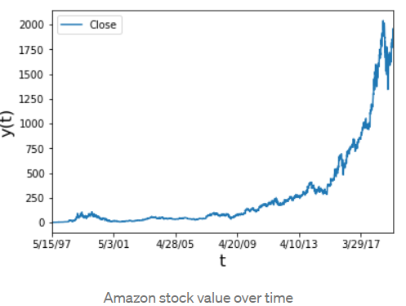
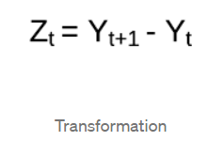
03
Non-Stationary Time Series
Applying this transformation, we get the following trend with an observable constant mean. The standard deviation is constant as well and seasonality doesn’t exist i.e. the series is now stationary.

Slide 43
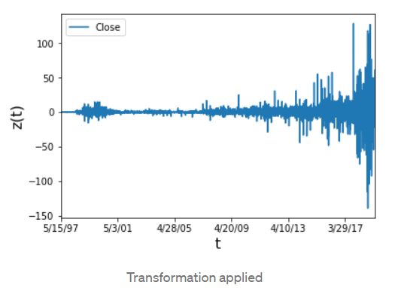
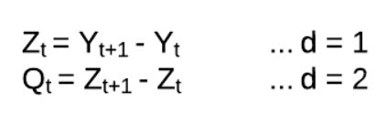
Integrated
03
I stands for Integrated (though it has nothing to do with integration). It just means that, instead of predicting the time series itself we will predict the differences of the series from one time step to the next time step. This is could done multiple times to make the series stationary.
This order of differencing (d) is an important parameter of ARIMA and determines the success of the model

Slide 44
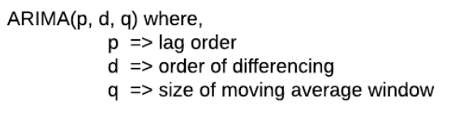
ARIMA Form
03
ARIMA is a widely used forecasting models due to its simplicity and its ability to generalise for non-stationary series.

